Slide 1
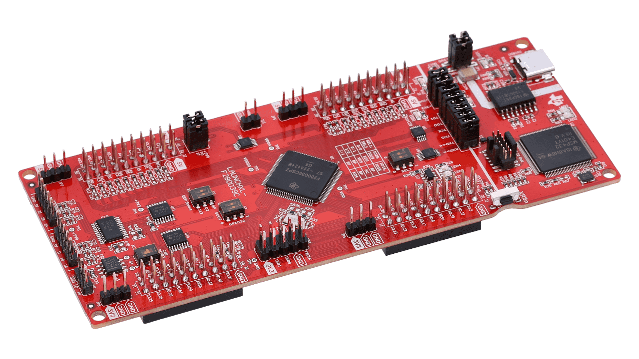

Team 1: ADC Resolution vs. Sensorless Motor Control Performance
Bi-Weekly Update 1 Cristian Ornelas, Tyler Hawkins, Tamara Basfar, John King Sponsor: Kevin Allen (Texas Instruments) TA: Fahrettin Ay
Notes:
Intro should take 30 seconds

Slide 2
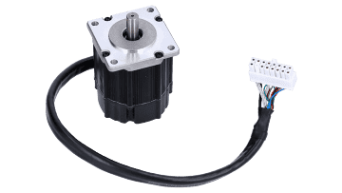
Project Overview
Problem
Conventional motor systems usually depend on sensored motor control to supply feedback, but these sensors can malfunction, particularly in unfavorable environments. There is an increasing need to simplify systems, improve dependability, and decrease cost expenses. On the other hand, with sensorless motor control, the drawback is that there is a lack of feedback at low speeds during startup.
Solution?
Notes:
30 seconds

Slide 3
Project Overview
Proposed Solution
Port solution for sensorless motor control on one of TI’s newest c2000 devices with enhanced features, then add new features and conduct an array of tests on the software to determine what set of sensorless control parameters are most effective, creating benchmarks.
Notes:
Texas Instruments has a developed sensorless control solution for an older launch pad and driver board. we were tasked with porting that solution over to a new MCU and driver along with adding some new specs and comparing performance.

Slide 4
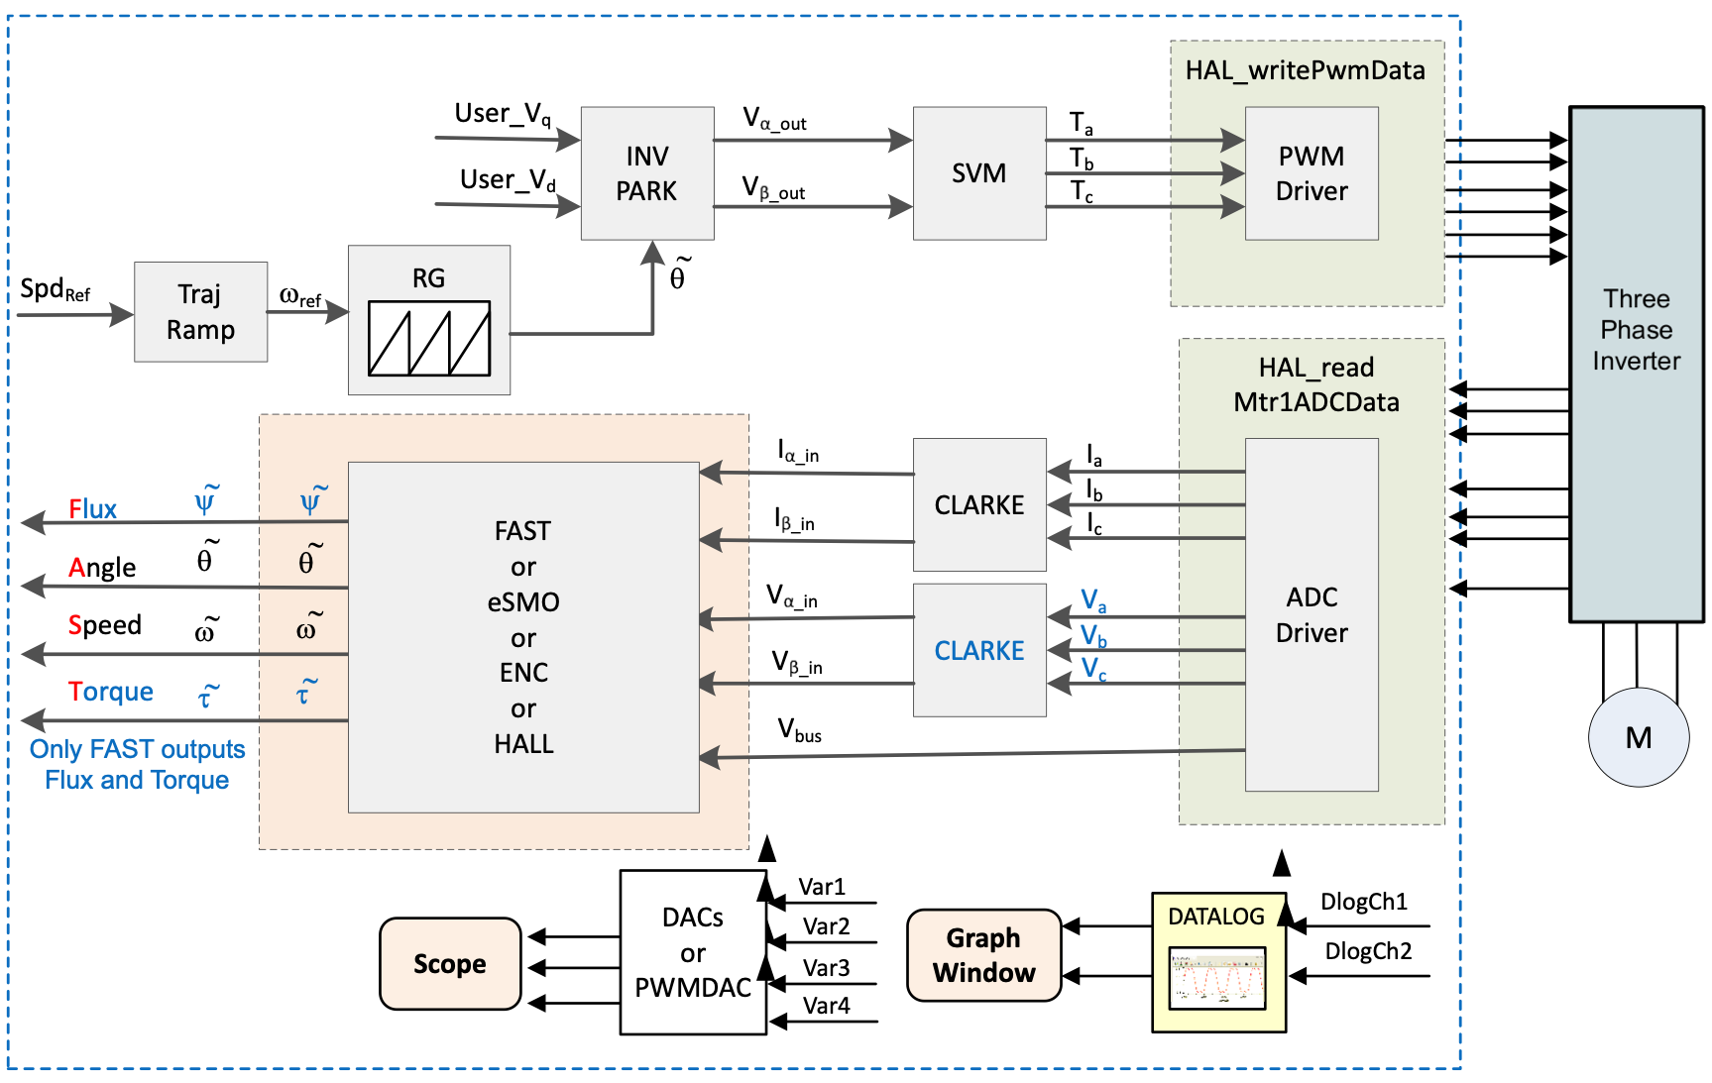
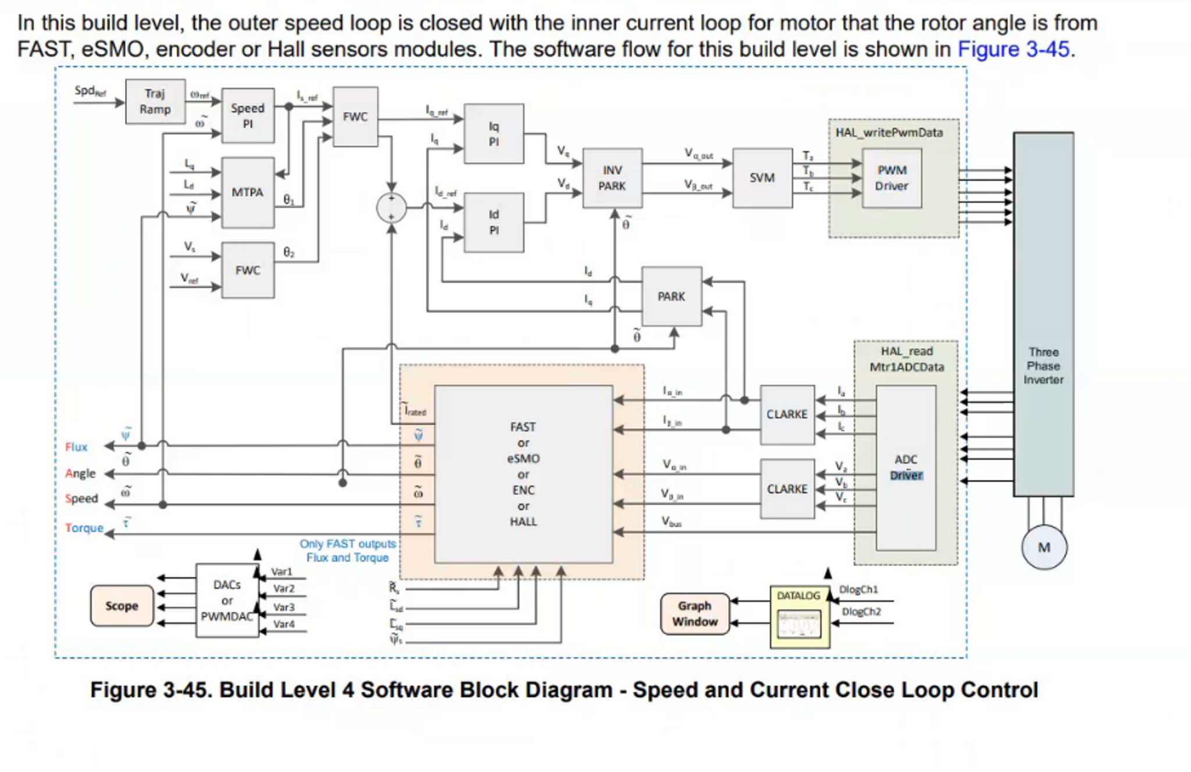
403 developed system
404 ported system

Slide 5
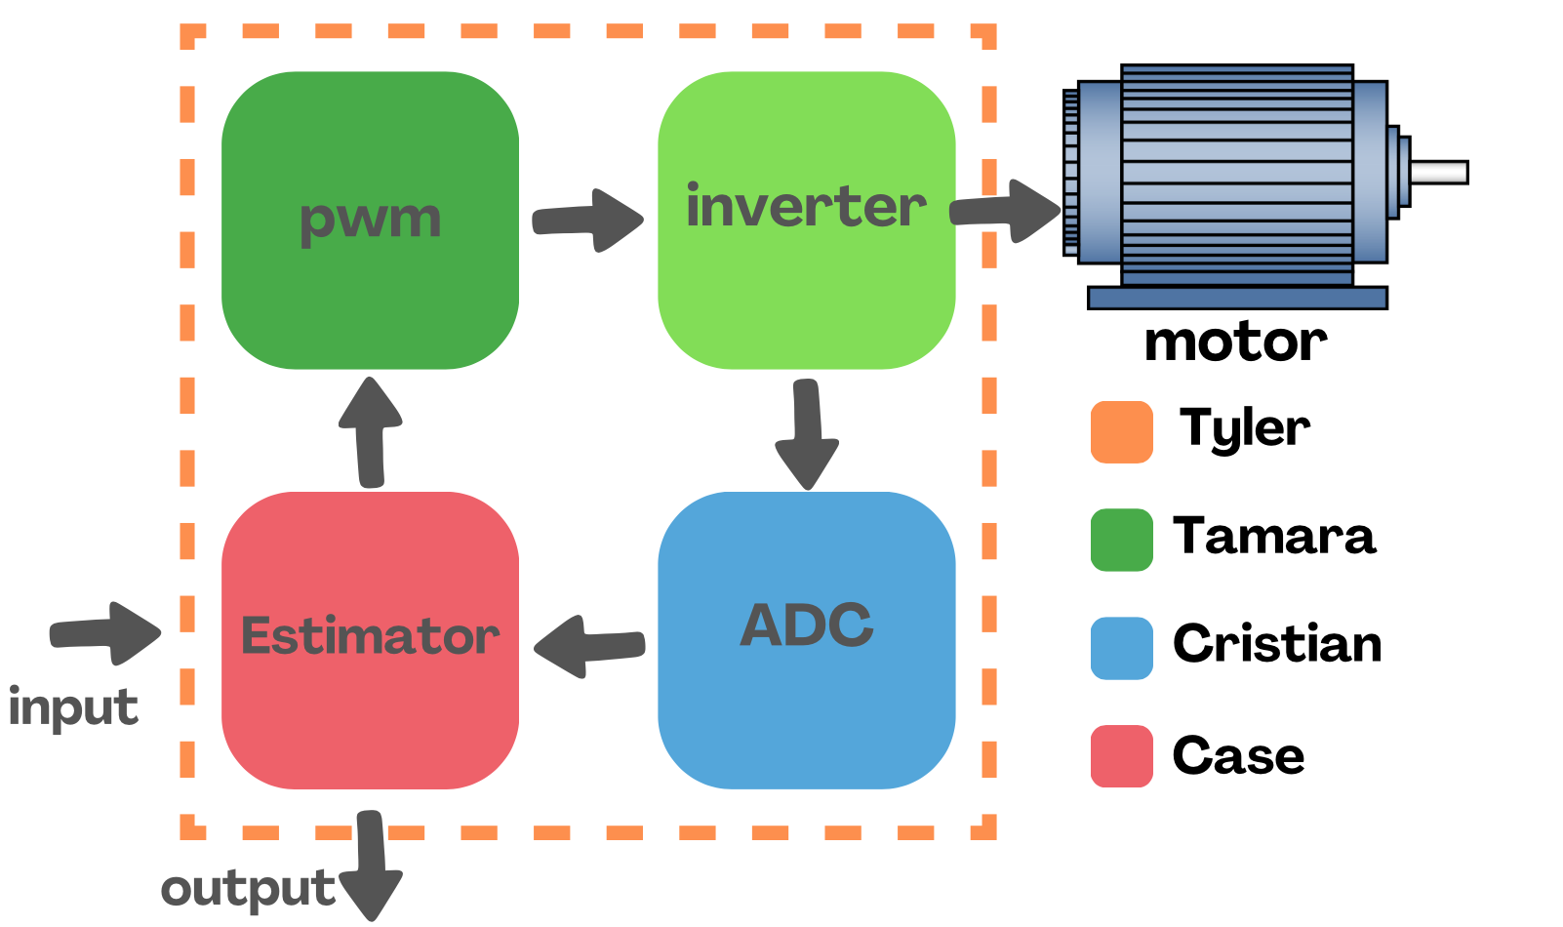
System Overview
Block diagram

Slide 6
Major Project Changes for 404
Changing subsystem motor control solution to be a stretch goal
Pivot to ported solution updates
Working together to develop changes side by side
Integrating Sysconfig support after other testing is complete
Notes:
45 seconds
Bullets on changes due to team membership changes -- describe how subsystem assignments, roles, project will change to accommodate team changes
Bullets on MAJOR changes in project direction due to learning from 403. If stuff didn’t work out now is the time to redirect

Slide 7
Project Timeline
Milestones | Progress
Port motor control solution to F28P65x Board | Resolving Final Errors
Modify software for ADC resolution (12/16) bit | Future
Modify software to run using 32/64 bit floating point | Future
Modify software to enable oversampling | Future
Run Tests on motor control performance | Future
Enable sysconfig support | Stretch goal
Notes:
30 seconds
-- Save discussion for subsystem update
-- Save detail for execution plan & validation plan status

Slide 8
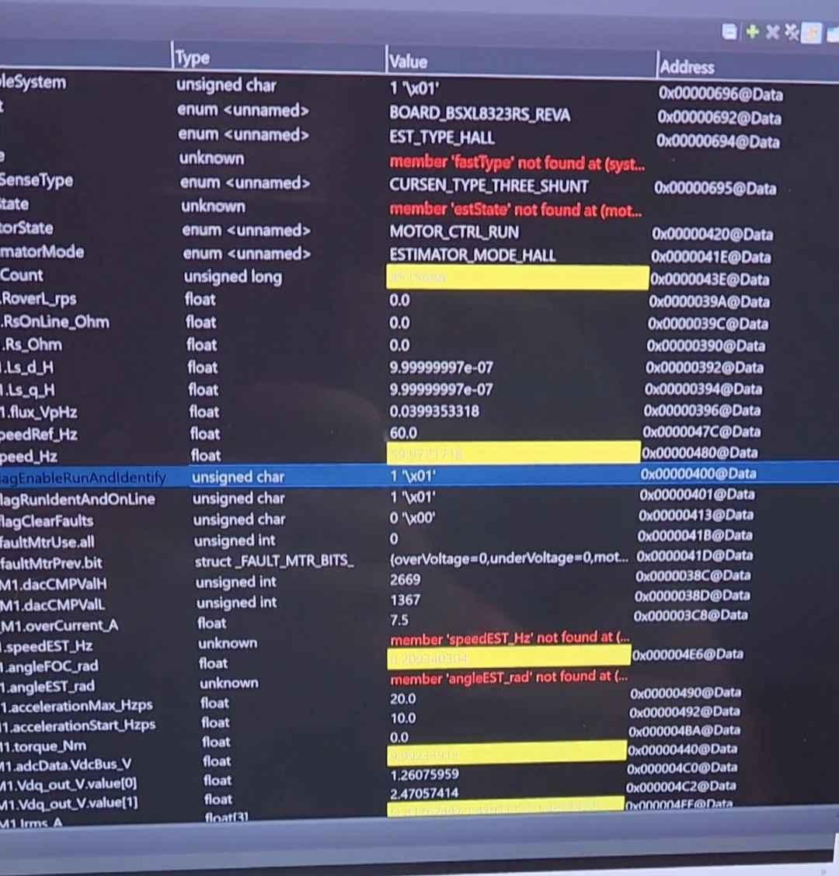
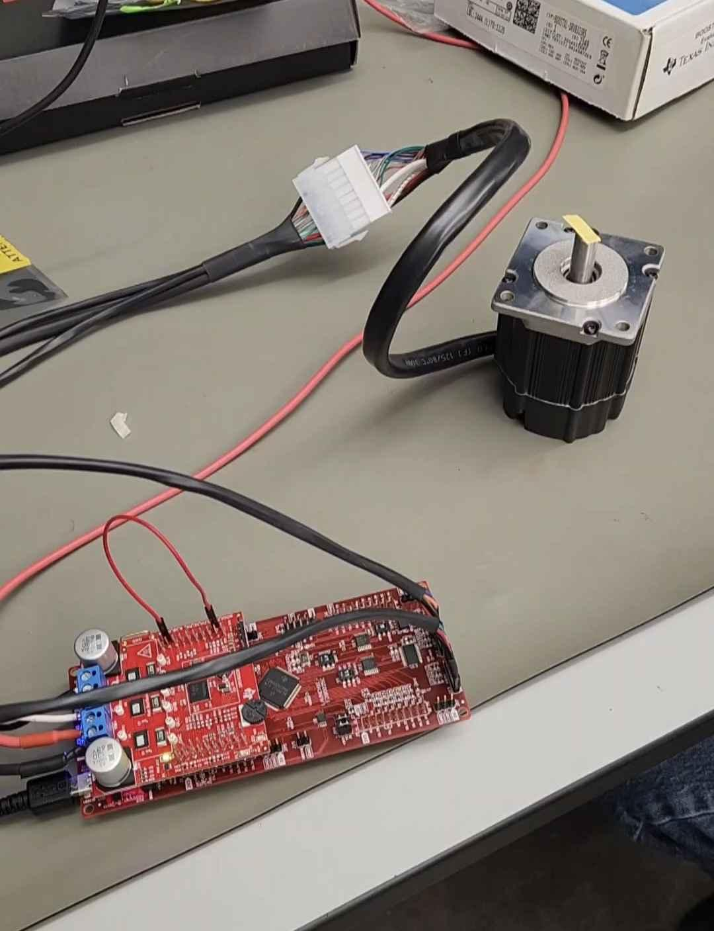
Solution Porting
Tyler Hawkins
Accomplishments since 403 10 hrs of effort | Ongoing progress/problems and plans until the next presentation
Able to run older motor control solution No compiling errors occur | Ported solution is currently not operational Get motor control solution fully functional
Notes:
45 seconds

Slide 9
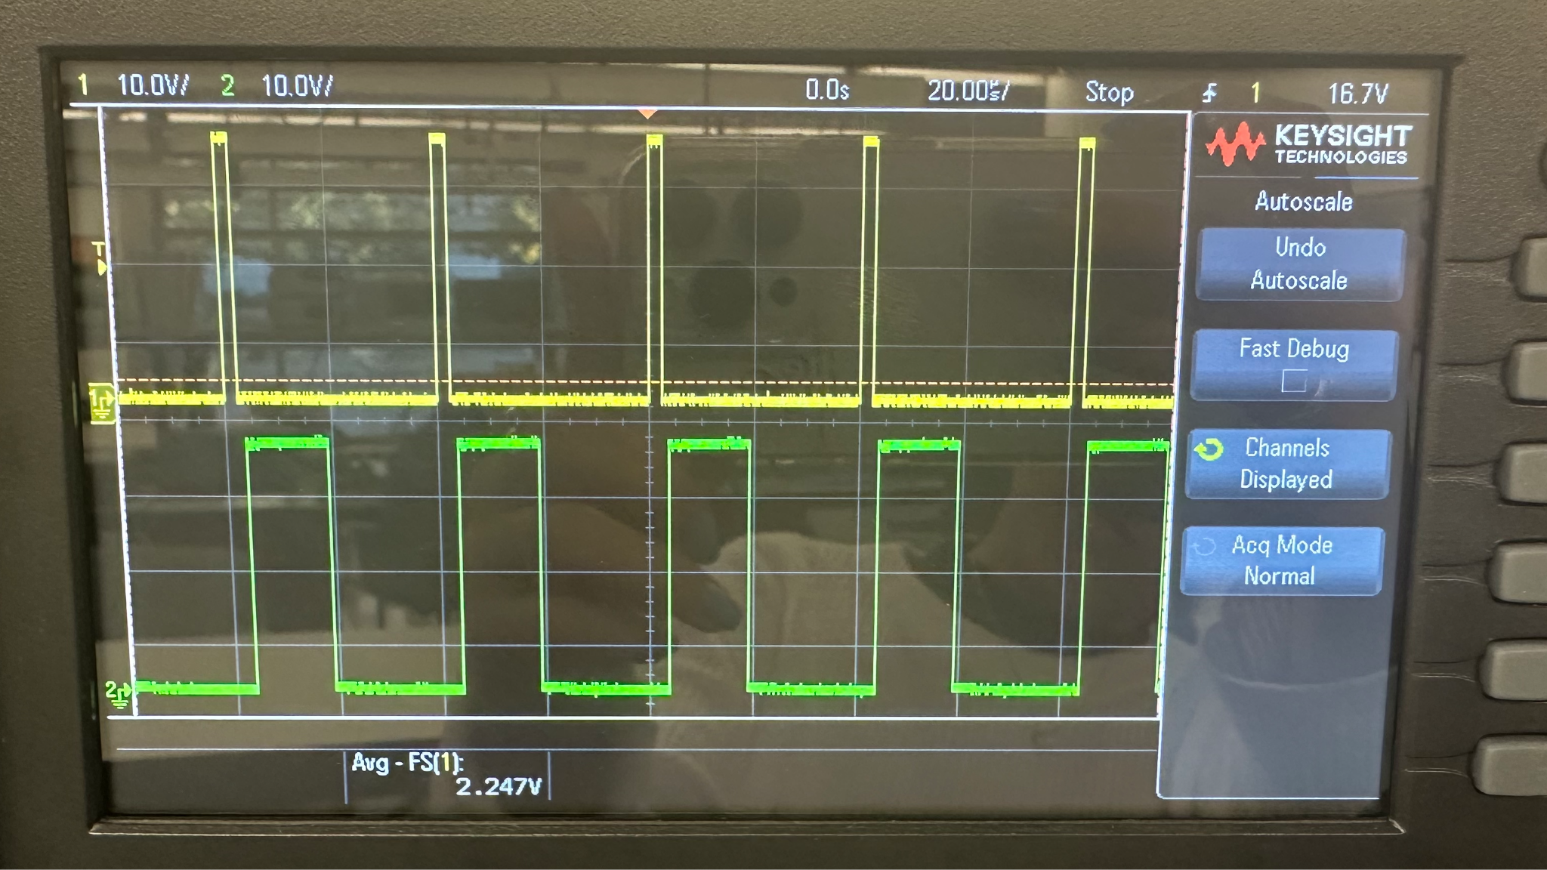
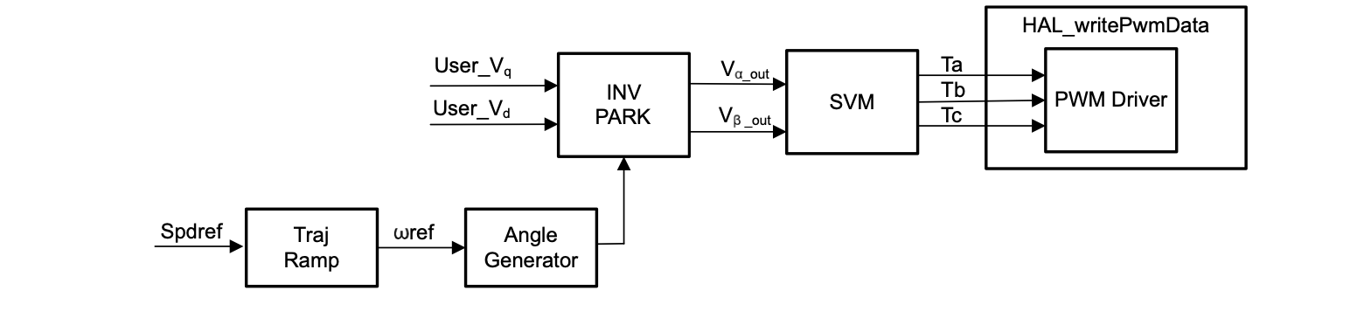
PWM Subsystem
Tamara Basfar
Accomplishments since 403 6 hrs of effort | Ongoing progress/problems and plans until the next presentation
pwm runs with no errors real time control gained | debug the pwm section of the ported solution and validate it
Notes:
45 seconds

Slide 10
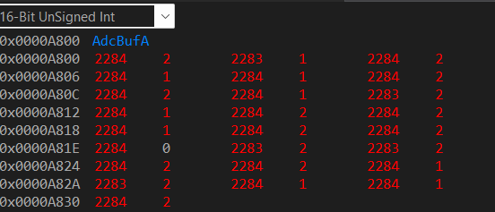
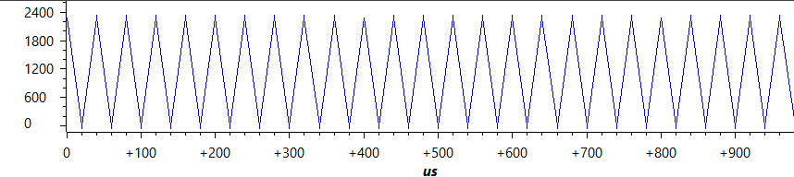
Analog-To-Digital Converter
Cristian
Accomplishments since 403 6 hrs of effort | Ongoing progress/problems and plans until the next presentation
The ADC functions properly There are no compiling errors when ran again | debug the ADC section of the ported solution and validate it
Notes:
45 seconds

Slide 11
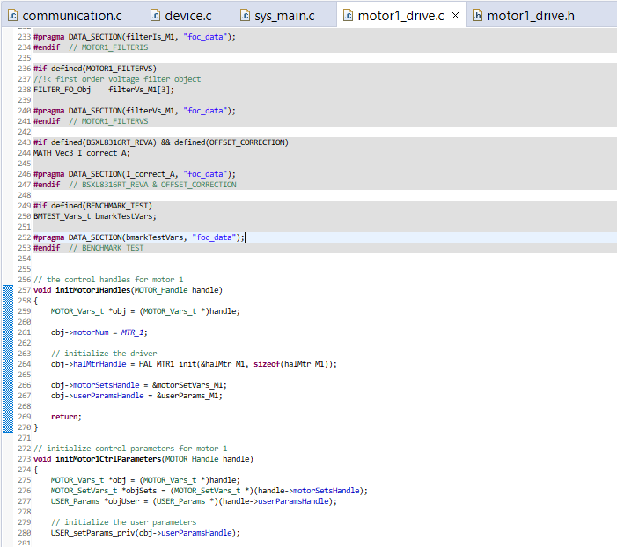
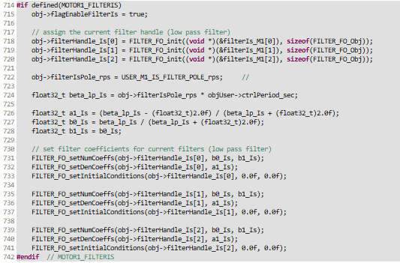
Stator Position Estimator
Case King
Accomplishments since 403 6 hrs of effort | Ongoing progress/problems and plans until the next presentation
Understanding of the ported estimator code has been achieved. The previous Estimator code functions without issue. | debug the Estimator section of the ported solution and validate it.
Notes:
45 seconds

Slide 12
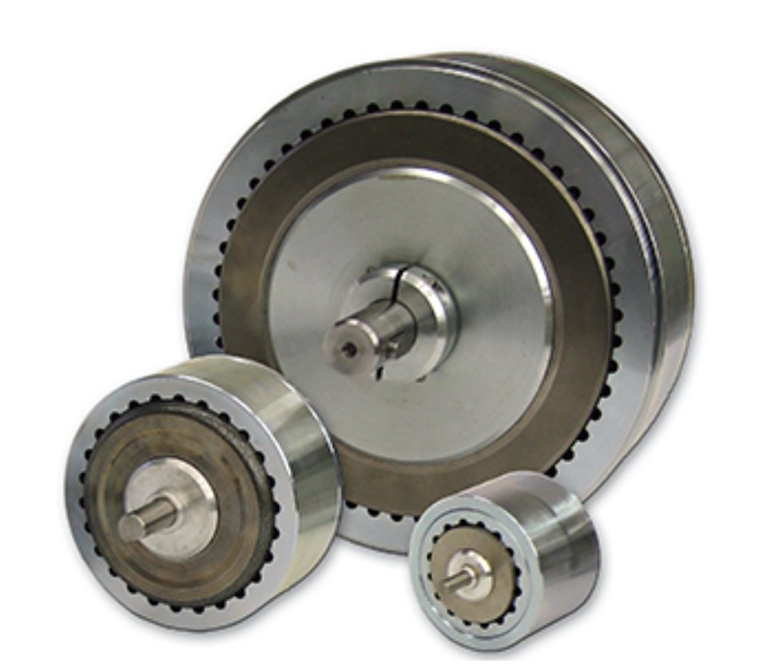
Parts Ordering Status
Hysteresis Brakes
Waiting on quote
Notes:
30 seconds
Most parts orders for 404 should be placed very soon.
Provide summary of what is ordered but not received and what remains to be ordered.
When do you expect to have all parts?

Slide 13
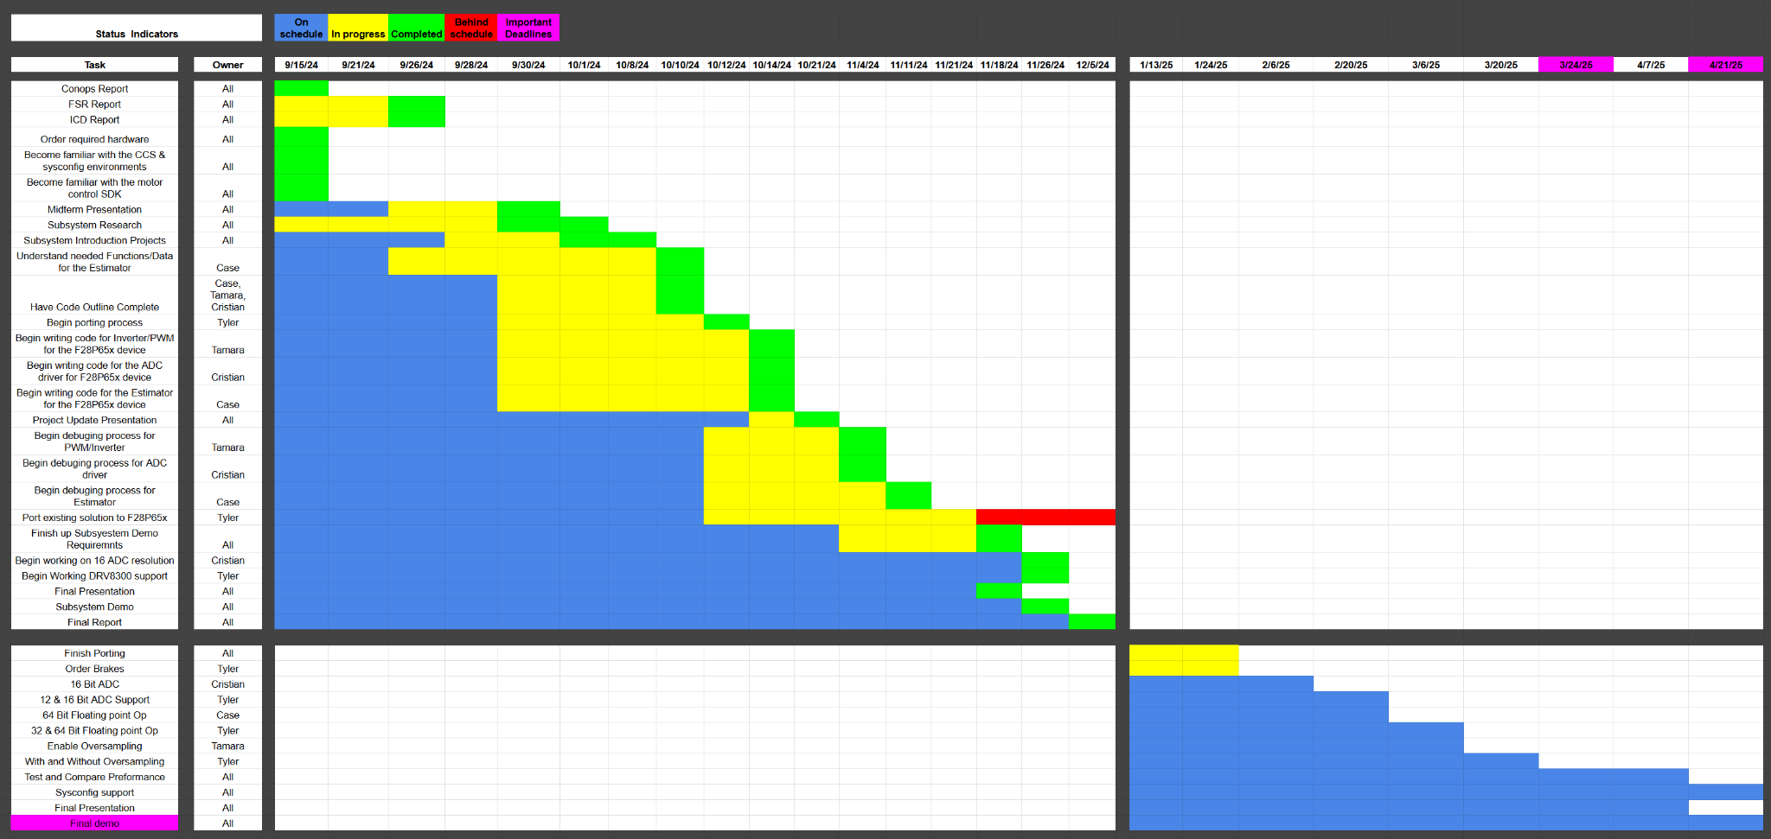
Execution & Plan
Notes:
45 seconds: 404 plan:
Continue porting
Test sensorless on new board/ driver
Implement then test:
16 bit ADC res
12 & 16 bit support
64 bit Floating point
32 bit Floating point
Compare performance
Sysconfig support
Test oversampling

Slide 14
Thanks and Gig’em!

